Slide 1
Python Web Scraping and Analysis Project
🔍

Slide 2
Main goal
The main goal of your analysis is to enhance search engine optimization (SEO) strategies by identifying key opportunities for improving website visibility, optimizing on-page elements, and increasing organic traffic, ultimately leading to higher conversion rates and improved overall performance in search rankings.

Slide 3
Table of contents
Obtaining the SerpAPI Key
Obtaining the NomicAPI Key
Initial Configuration
Analyses in the project
4.1. Meta Description Length Analysis
4.2. Keyword in Meta Description Analysis
4.3. Keyword in Title Analysis
4.4. Title Length Analysis
4.5. Duplicate Title Analysis
4.6. URL Length Analysis
4.7. Parameteres in URL Analysis+
5. Project summary
6. Business conclusions

Slide 4


To get started, you need two things:
1) the SerpAPI key
2)the NomicAPI key
🏠

Slide 5
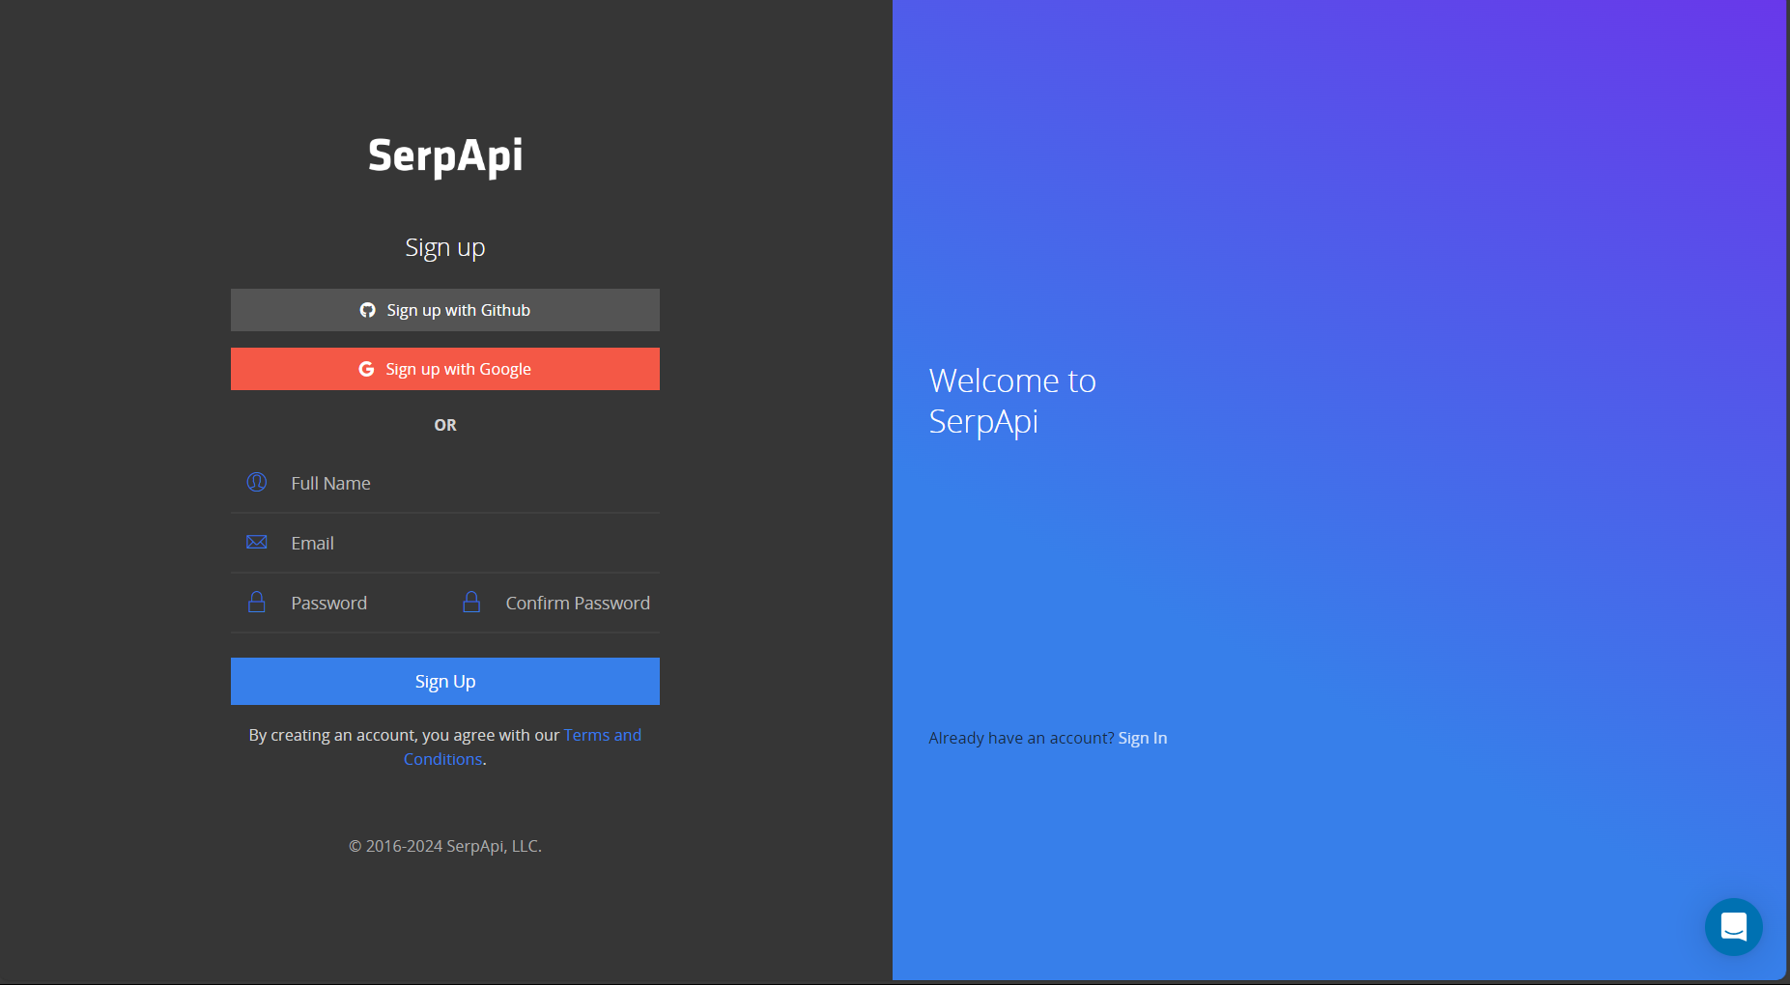
Obtaining the SerpAPI Key
🏠
Go to the website https://serpapi.com/users/sign_up if you’re using this service for the first time, please sign up with Google

Slide 6
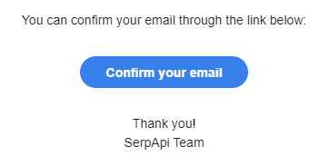
Obtaining the SerpAPI Key
🏠
2. You will receive a registration confirmation email, and you need to click the "Confirm your email" button.

Slide 7
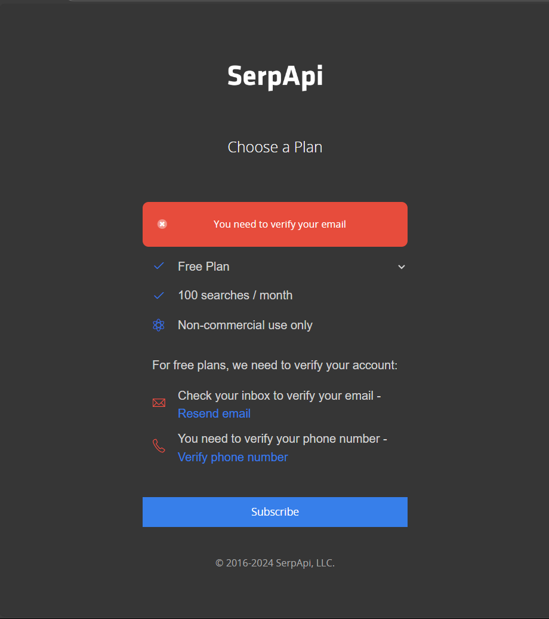
Obtaining the SerpAPI Key
🏠
3. You will be redirected to https://serpapi.com/users/welcome , and you will need to choose a service plan. For our needs, the free plan will suffice. Select it and click the "Subscribe" button.

Slide 8
Obtaining the SerpAPI Key
🏠
4. Next, you need to verify your phone number. Click "Verify phone number," enter your phone number, and click the "Send code" button to receive an SMS with the activation code. Then, follow the instructions according to the SMS and the SerpAPI website.

Slide 9
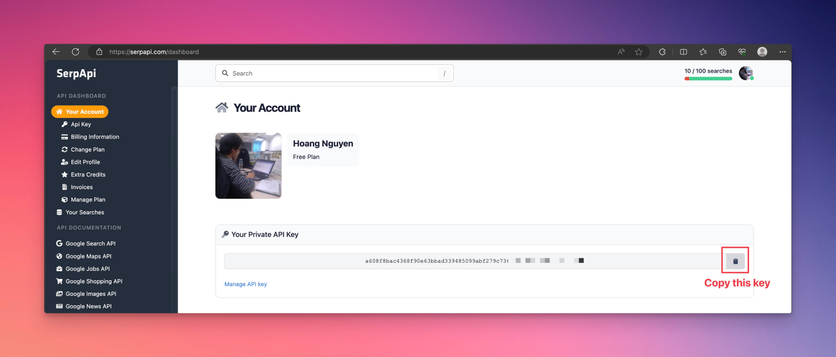
Obtaining the SerpAPI Key
🏠
5. Sign in and go to https://serpapi.com/dashboard , then copy the key at "Your Private API Key" section. Keep it secret. It will come in handy later.

Slide 10
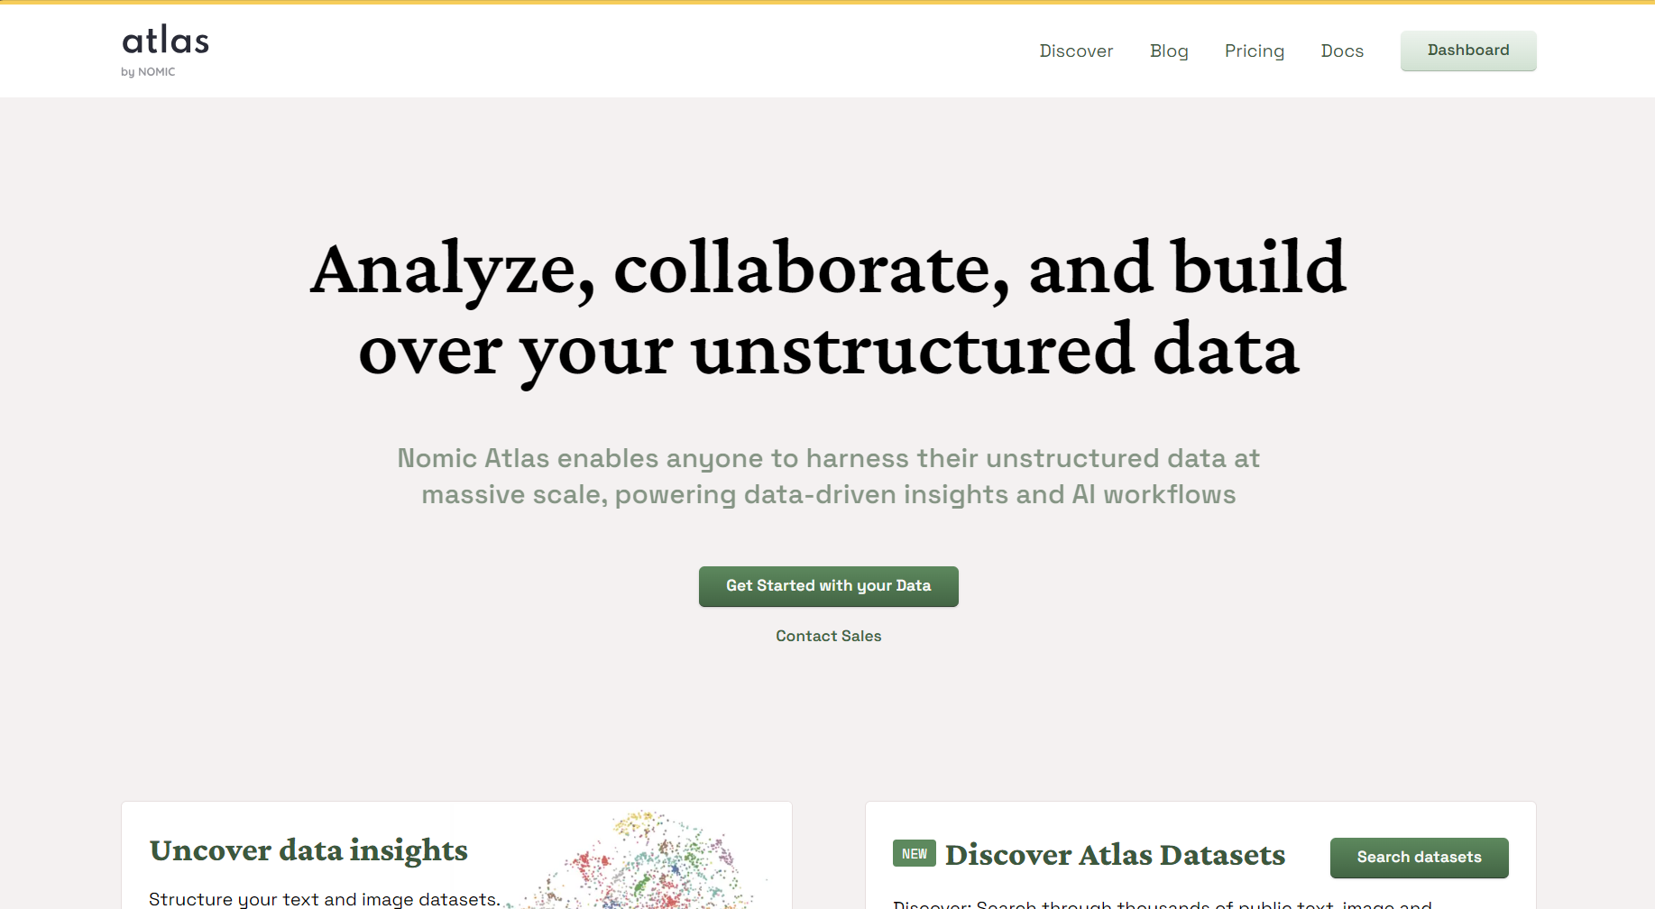
Obtaining the NomicAPI Key
🏠
Go to the website https://atlas.nomic.ai/ and click the "Get started with your Data" button. Then, create your account by setting up a username and password.

Slide 11
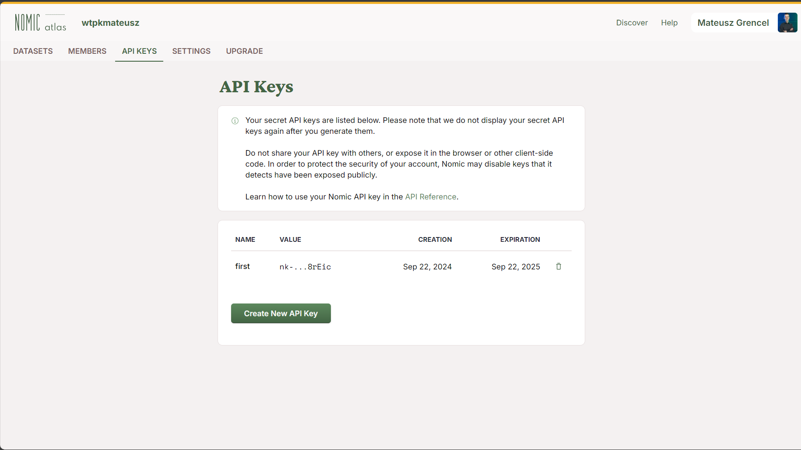
Obtaining the NomicAPI Key
🏠
2. If you are logged in, go to the "API Keys" tab. Then, click the "Create new API Key" button. Keep it secret. It will come in handy later.

Slide 12
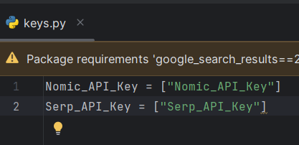
Initial Configuration
🏠
Please open the file keys.py. Paste the API keys: Serp_API and Nomic_API instead of [“Nomic_API_Key”] and [“Serp_API_Key”]
The API key should look like this: Nomic_API_Key = "my-nomic-api-key1234"

Slide 13
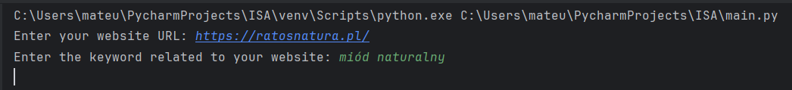
🏠
Please open the file main.py. You will be prompted to enter a URL and a phrase

Slide 14
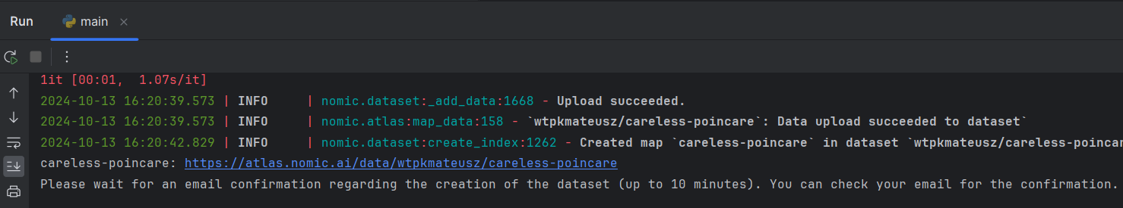
🏠
You will receive a notification that a new knowledge graph has been created in Nomic. Now, you need to wait up to 10 minutes for a confirmation email.

Slide 15
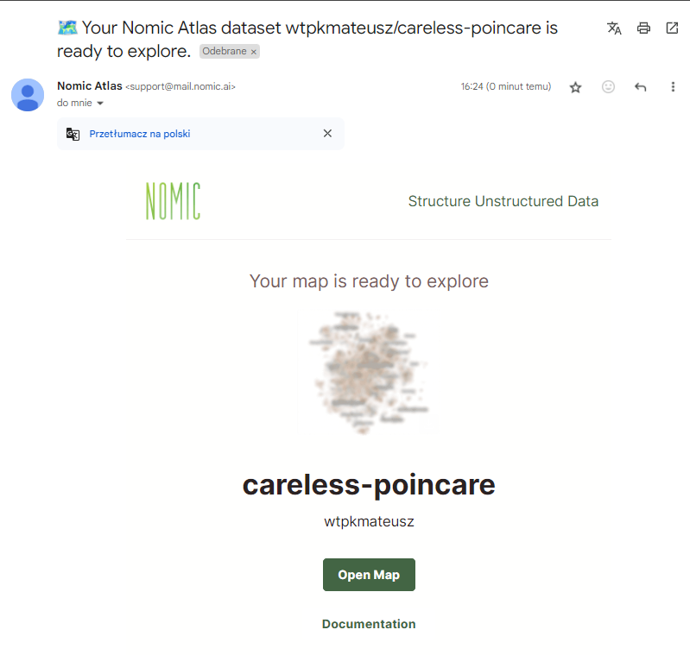
🏠
After processing, which will take up to 10 minutes, you will receive an email with the completed map from Nomic. Please open it using the email associated with your Nomic account. Copy the dataset ID name (in this case, it is careless-poincare).

Slide 16
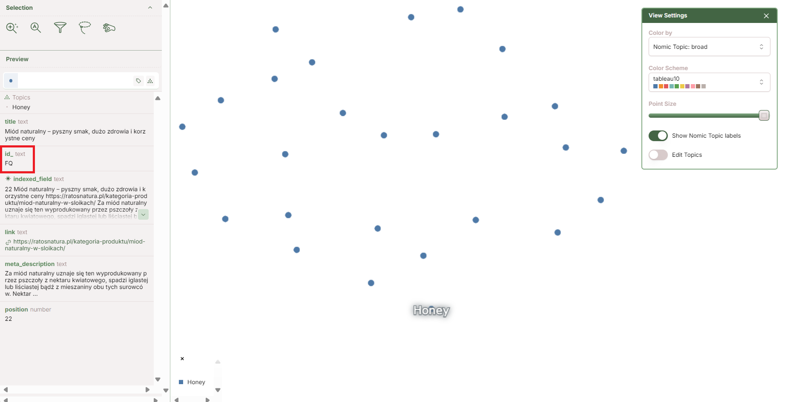
🏠
Once the map is opened, copy your ID from our page (here, it is FQ).

Slide 17
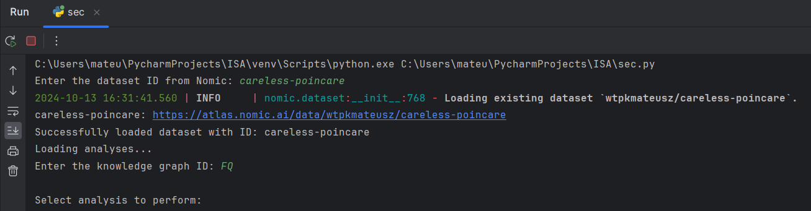
🏠
Now you can perform various analyses by running the sec.py script.
You need to provide the dataset ID from Nomic (here, it is careless-poincare) as well as the ID from our page (here, it is FQ).

Slide 18
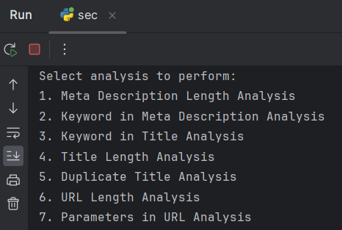
Analyses in the project
🏠

Slide 19
Meta Description Length Analysis
🏠
The meta_desc_length_analysis function analyzes the lengths
of meta descriptions in a DataFrame.
It first prompts the user for the minimum and maximum lengths of the meta descriptions,
validating the input.
The function then calculates the length of each description, adding a new column to the DataFrame.
It filters the data to include only descriptions within the specified
length range. The function prints a message indicating the lengths
of the meta descriptions within this range.
It highlights the relevant row using the highlight_rows_local function.
A histogram is created, with the x-axis representing the lengths and the y-axis indicating
whether at least one description exists for that length.
Finally, the user is prompted to press Enter to return to the menu.

Slide 20
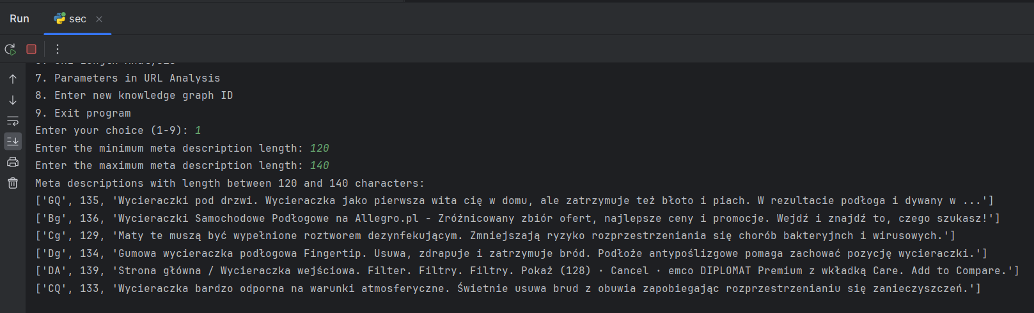
🏠

Slide 21
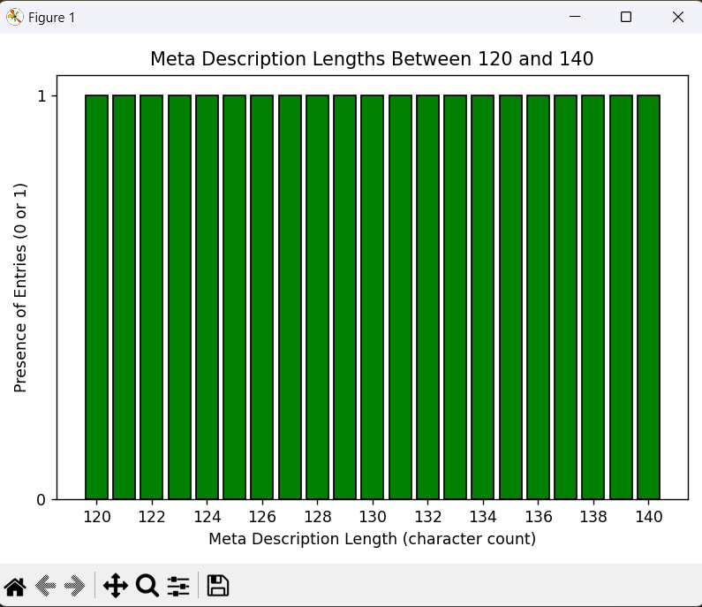
🏠

Slide 22
Keyword in Meta Description Analysis
🏠
The keyword_in_meta_description_analysis function analyzes occurrences of a
keyword in meta descriptions within a DataFrame.
The user is prompted to enter a keyword to search for, which is then escaped to avoid issues with
regular expressions.
The function counts occurrences of the keyword in the meta description column, creating
a new column with the count.
It then prints information about the number of occurrences of the keyword.
Rows containing the keyword are highlighted using the highlight_rows_local function.
The function separates counts for cases with 0 occurrences and 1 or more occurrences.
A bar plot is created, with the x-axis representing the number of occurrences and the y-axis showing
the number of entries. Finally, the user is prompted to press Enter to return to the menu.

Slide 23
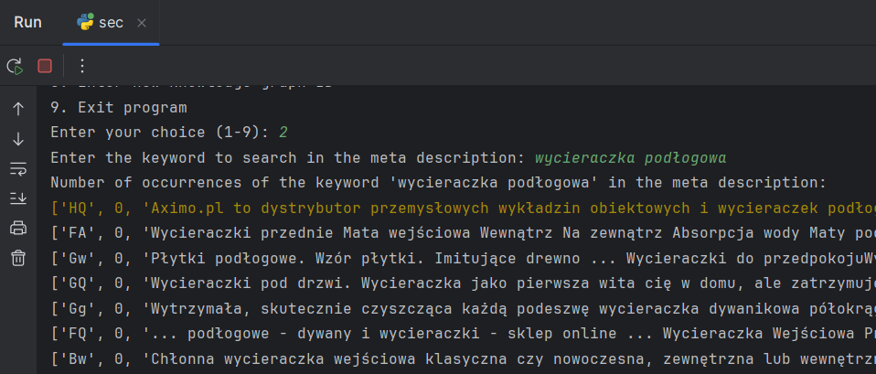
🏠

Slide 24
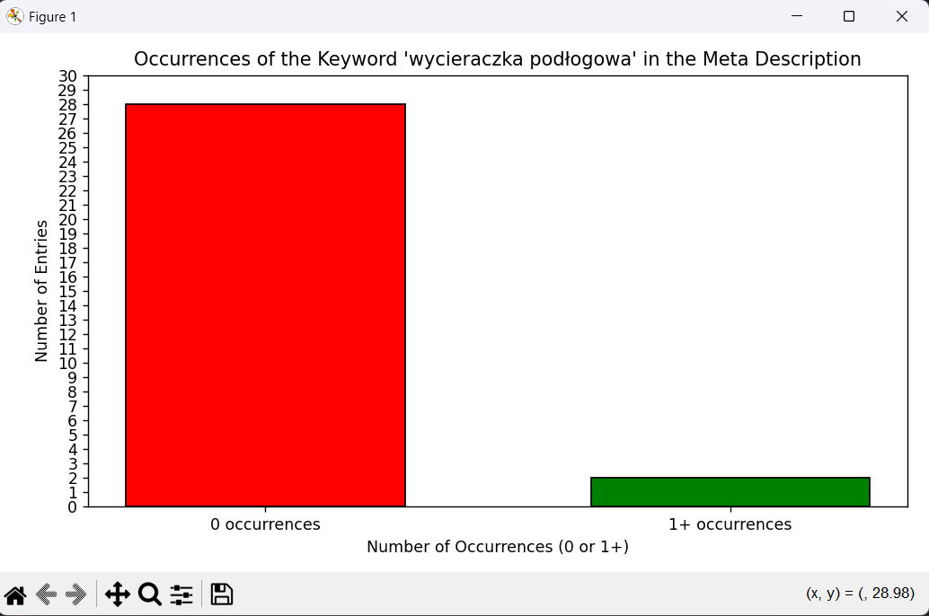
🏠

Slide 25
Keyword in Title Analysis
🏠
The keyword_in_title_analysis function analyzes occurrences of a keyword in titles within a
DataFrame.
The user is prompted to enter a keyword to search for, which is then escaped
to avoid issues with regular expressions.
The function counts occurrences of the keyword in the title column, creating
a new column with the count.
It then prints information about the number of occurrences of the keyword in the titles.
Rows containing the keyword are highlighted using the highlight_rows_local function.
The function separates counts for cases with 0 occurrences and 1 or more occurrences.
A bar plot is created, with the x-axis representing the number of occurrences and
the y-axis showing the number of titles.
Finally, the user is prompted to press Enter to return to the menu.

Slide 26
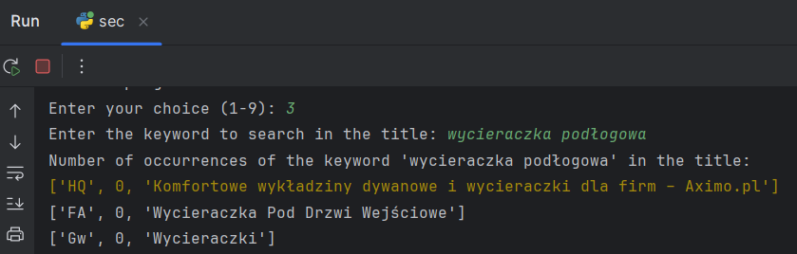
🏠

Slide 27
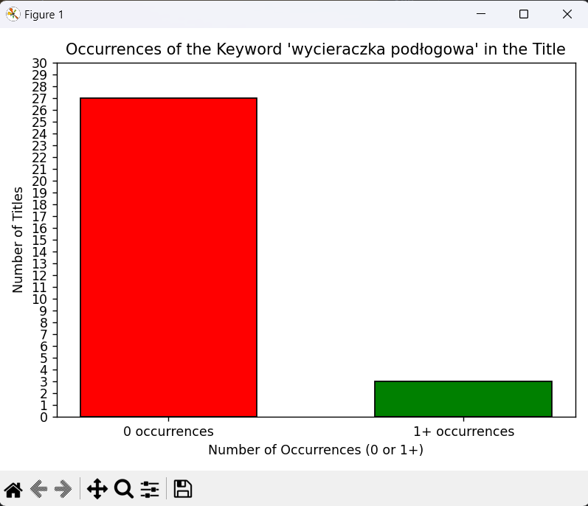
🏠

Slide 28
Title Length Analysis
🏠
The title_length_analysis function analyzes title lengths within a DataFrame,
allowing the user to define a range of lengths.
The user is prompted to enter minimum and maximum title lengths, and
the function provides error handling to ensure valid input.
It then calculates the lengths of the titles and filters the DataFrame based on the specified range.
Titles that fall within the defined length are displayed.
Rows matching the criteria are highlighted using the highlight_rows_local function.
The function counts occurrences of each title length in the filtered DataFrame
and creates a histogram, where the bar colors indicate the presence
or absence of occurrences. The x-axis represents title lengths, and the y-axis shows the number of titles.
Finally, the user is prompted to press Enter to return to the menu.

Slide 29
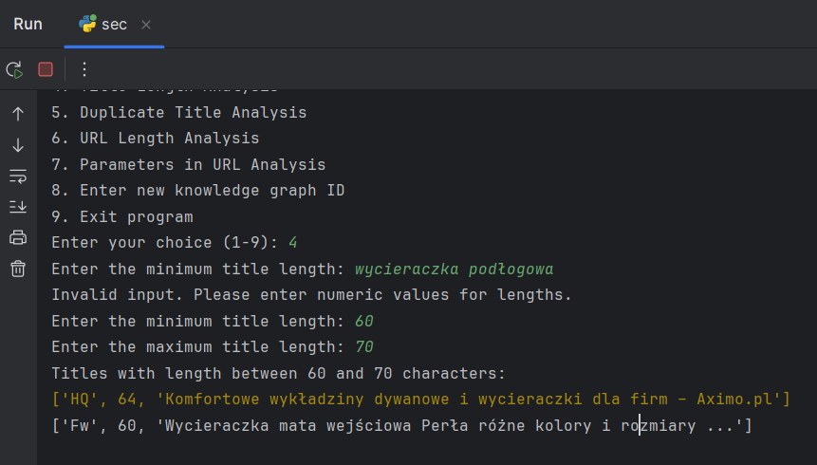
🏠

Slide 30
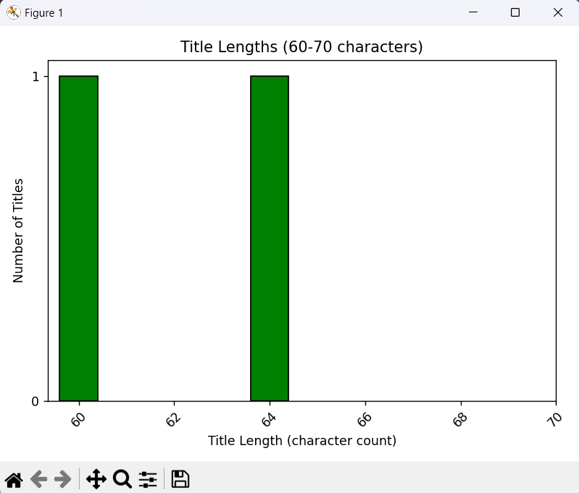
🏠

Slide 31
Duplicate Title Analysis
🏠
🏠
The duplicate_title_analysis function identifies titles that are duplicated within the DataFrame.
It searches for duplicate titles and displays them along
with their ID, link, and meta description information using the highlight_rows_local function.
The function then counts occurrences of each title to identify those that appear
more than once.
It generates a histogram showing the number of titles based on the number of their
duplicates. The x-axis represents the number of duplicates, while the y-axis shows the
number of titles. The histogram is colored red with a black edge for better visualization.
After displaying the histogram, the user is prompted to press Enter to return to the menu.
This function provides an easy way to identify and analyze problematic titles in the dataset.

Slide 32
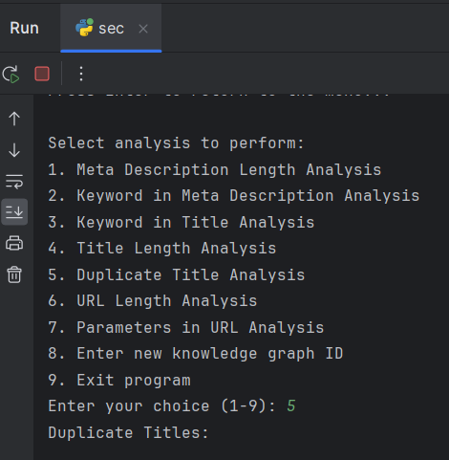
🏠

Slide 33
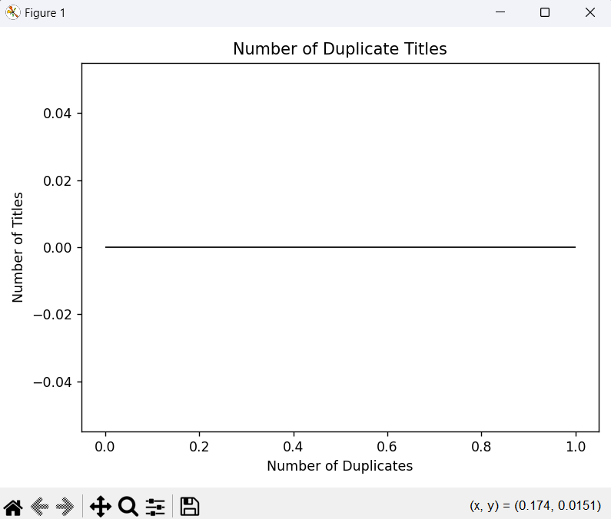
🏠

Slide 34
URL Length Analysis
🏠
The url_length_analysis function analyzes the lengths of URLs in a DataFrame.
It first prompts the user to input the minimum and maximum URL lengths,
providing error handling for invalid input.
The function then calculates the length of each URL by adding a new column to the DataFrame.
It filters the data to include only those URLs whose lengths fall within the specified range.
The function displays the filtered URLs along with their lengths using the highlight_rows_local function.
It creates a histogram of URL lengths, with the x-axis representing the lengths and
the y-axis showing the number of URLs. The x-axis ticks are set to increment by 5, while
the y-axis shows whole numbers.
After completion, the user is prompted to press Enter to return to the menu.

Slide 35
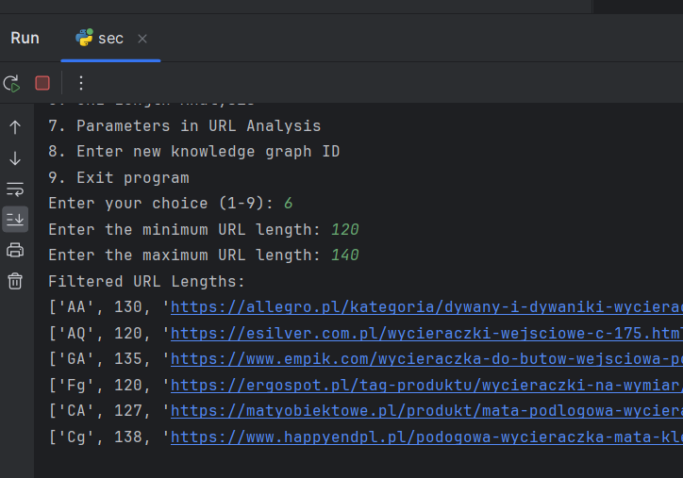
🏠

Slide 36
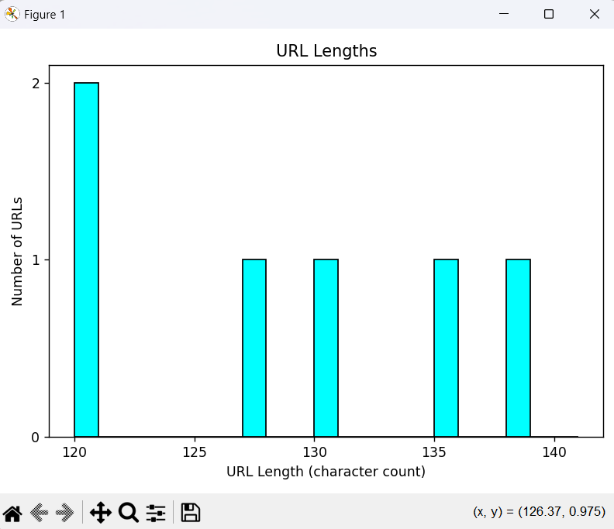
🏠

Slide 37
Parameters in URL Analysis
🏠
The params_in_url_analysis function analyzes URLs in a DataFrame for parameters.
It begins by checking if a URL contains parameters, adding a new column to indicate this.
Next, it counts the number of parameters in each URL by splitting at the question mark (?).
The function extracts the query parameters for display and presents the URLs with
parameters, showing their IDs and values. It uses the highlight_rows_local function
to highlight the relevant rows in the DataFrame, displaying the ID, URL, and parameter count.
The function then creates a histogram of the number of parameters in the URLs, with
the x-axis representing the number of parameters and the y-axis showing the number
of URLs. Both axes are configured to show whole numbers.
After completion, the user is prompted to press Enter to return to the menu.

Slide 38
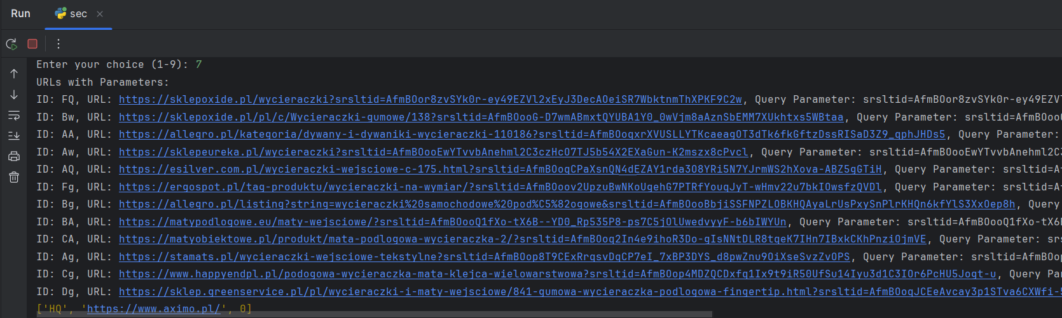
🏠

Slide 39
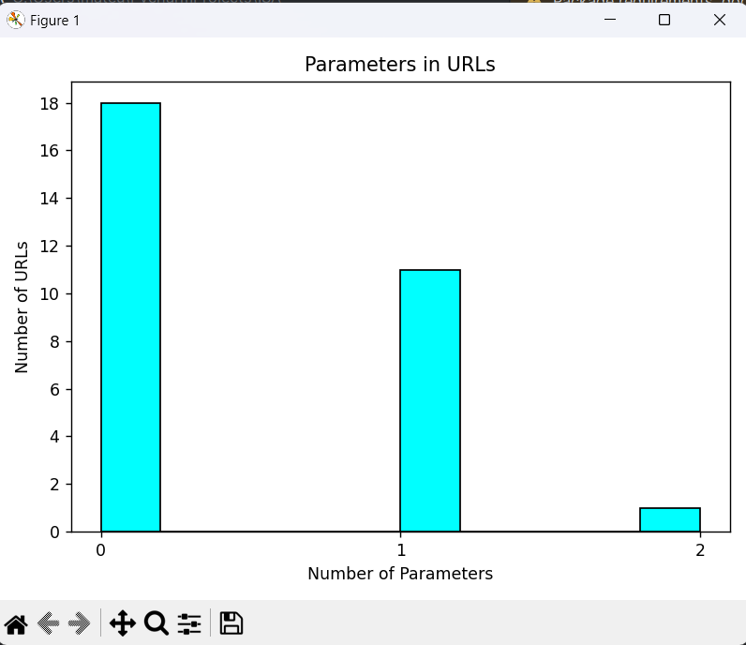
🏠

Slide 40
Project summary
🏠
Many meta descriptions are either too short or too long, which can impact visibility in search engines. The ideal meta description length is typically between 150 and 160 characters, and analyses can indicate which entries require optimization.
Analyses reveal which keywords are most frequently used in meta descriptions and titles. A high occurrence of a specific keyword may indicate the popularity of a topic, but it may also suggest the need for further content optimization to improve SEO rankings.
Many entries in the database have duplicate titles, which can affect SEO and user experience. Identifying duplicate titles can help in editing or removing them, thereby improving the uniqueness of the content.
Analyzing URL length may reveal that many links are excessively long. Long URLs can be less user-friendly and inefficient for SEO. Optimizing URL length should be considered to make them more concise and easier to remember.
The number of parameters in URLs can indicate a complex site structure. Too many parameters can negatively impact indexing by search engines. Identifying such URLs can assist in simplifying the structure and improving SEO performance.
Data analysis may uncover certain patterns or trends in user behavior, such as preferences for specific keywords or titles. This information can be valuable for future marketing strategies and in creating content that better meets audience needs.

Slide 41
Recommendations for business
🏠
Revise meta descriptions to ensure they fall within the optimal length (150-160 characters).
This can improve click-through rates from search engine results and enhance visibility.
Conduct keyword research to identify relevant and high-traffic keywords. Integrate these keywords
more effectively into titles and meta descriptions, ensuring they align with user intent.
Review the database for duplicate titles and take action to make them unique. This can help improve
SEO rankings and avoid confusion for users.
Simplify lengthy URLs by removing unnecessary parameters and making them more concise. Aim for
user-friendly URLs that are easy to read and remember, which can positively impact SEO.
Analyze URLs for excessive parameters and consider restructuring the website to minimize them.
This can improve site indexing by search engines and enhance user experience.
Use the insights gained from analyzing user behavior patterns and trends to inform content strategy.
Create targeted content that aligns with audience interests and search behavior to drive engagement and conversions.

